Slide 1


Slide 2
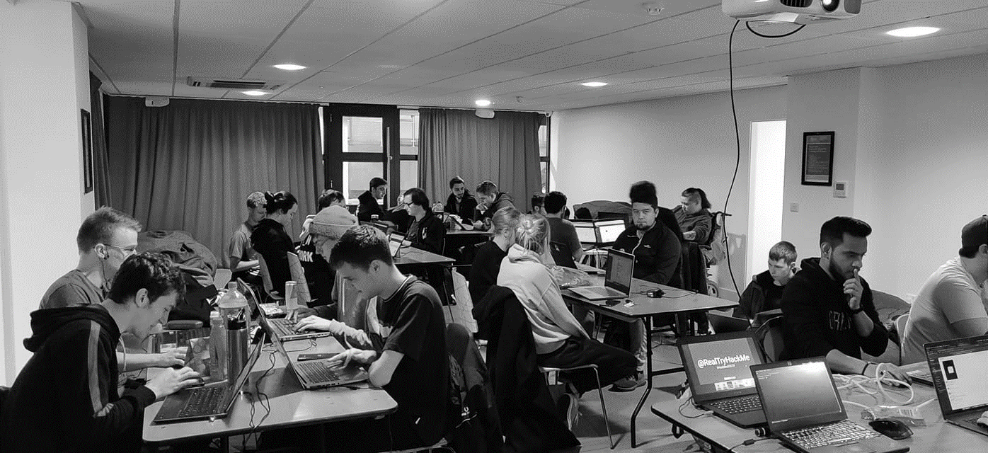



/dmuhackers
@dmuhackers
Password Cracking

Slide 3



Disclaimer
Don’t do illegal shit

Slide 4
Overview
Today we are gonna cover Password Cracking. The practical part of today’s session will be on TryHackMe.com, and we will use the new Kali Builds.

Slide 5
Password Cracking
Put simply, Password Cracking is the act of breaking Password Hashes.
A hash is a function that outputs to a fixed length and is used for passwords as even the tiniest change will seriously change the Hash
Common Hashing algorithms that you will see in CTFs are MD5, NTLM and SHA- family hashes

Slide 6
Tools
The three tools being covered today are:
John the Ripper: A Password cracking tool
Hashcat: A password cracking tool
Name the Hash/ Hash ID: Hash Type Detection
There are tons of tools out there that can be used, these are just a few of my favourites

Slide 7
John The Ripper
John the Ripper is a decent password cracker, that works with a wide range of different hashing algorithms.
The reason why I normally use JTR over Hashcat is for the other tools that come along side with JTR, such as SSH2John.py
John is built into Kali Linux by default
An example command would be john –wordlist=/usr/share/wordlists/rockyou.txt hash

Slide 8
Hashcat
Hashcat is a decent password cracker, that works with a wide range of different hashing algorithms.
Hashcat is really useful when you need to crack hashes faster, as it can use your GPU.
Hashcat is built into Kali Linux by default
An example command would be hashcat –a 0 -m x hashfile dictionary file

Slide 9
Name That Hash/ Hash ID
Name that hash is a hash identifier.
This is useful as this allows for your password cracker to specifically target that type of hash
This reduces the time it takes to crack that hash
Name that Hash builds upon Hash ID and other hash identifying programs which have since become defunct or not updated.
I have installed Name that Hash on all of the Kali images, and there is also a website that can be used

Slide 10
Questions
Any Questions?

Slide 11
Practical
For today’s practical, we are doing the ‘Crack the Hash’ room on TryHackMe.com
There will be an advanced challenge on the next page for those that complete that room early, or those that have already completed it.

Slide 12
Advanced Challenge
1. 5bd16e366a7472c1ff9cc9b87510a9b49e237461287ac59bd569e532234dd4143a03c55e3de7523a17fb196d72e13b33833f4d903b06ee7e2811c4df18662b69
2. de5cff964dbecc44087dc0f773d0f68df1e1530874d83977c5aa9aae9895748f98ec79bfb3fa89a01740f6bec72c1eb4
3.
$2a$10$M0R8xtLmgiK3C4HEfHanRuX32dB772f.1dCAMJQxEmn6c9xbGaewq

